Slide 1
Practitioner’s guide to calculating the efficiency of a consultation or engagement process
by John May
doctorjohnmay@gmail.com
December 2013

Slide 2
Introduction
This guide shows how to measure the efficiency of a consultation or engagement process by calculating the “Effective Number of Issues” generated.
You will need a list of the different issues that arose, and the number of times each one occurred.
These slides use data from a consultation about priorities for the Mayor of Bristol to show how to calculate the Effective Number of Issues, step by step.

Slide 3
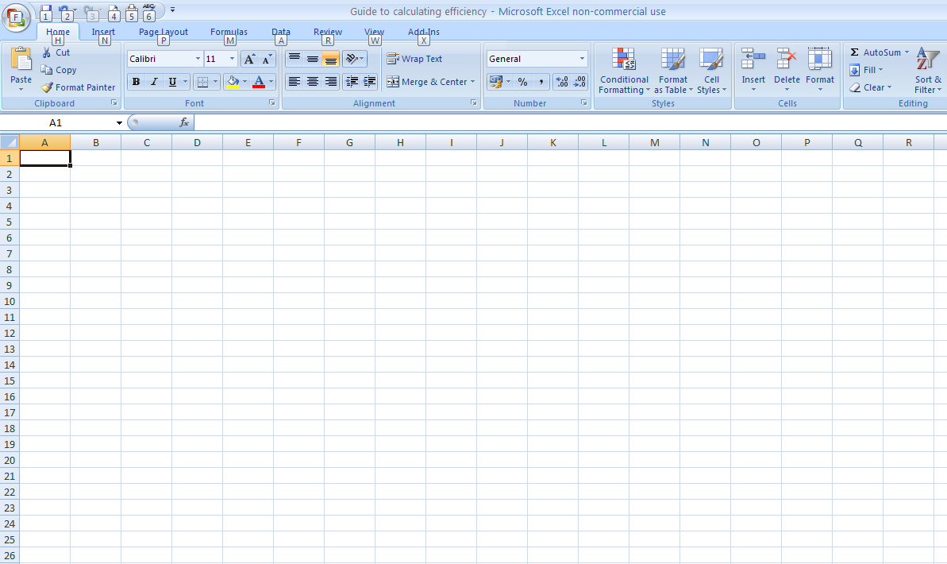
1. Enter your issues
in the first column;
2. enter their frequency in the next;
3. and then use the third to calculate the relative frequency.
Like this ...

Slide 4
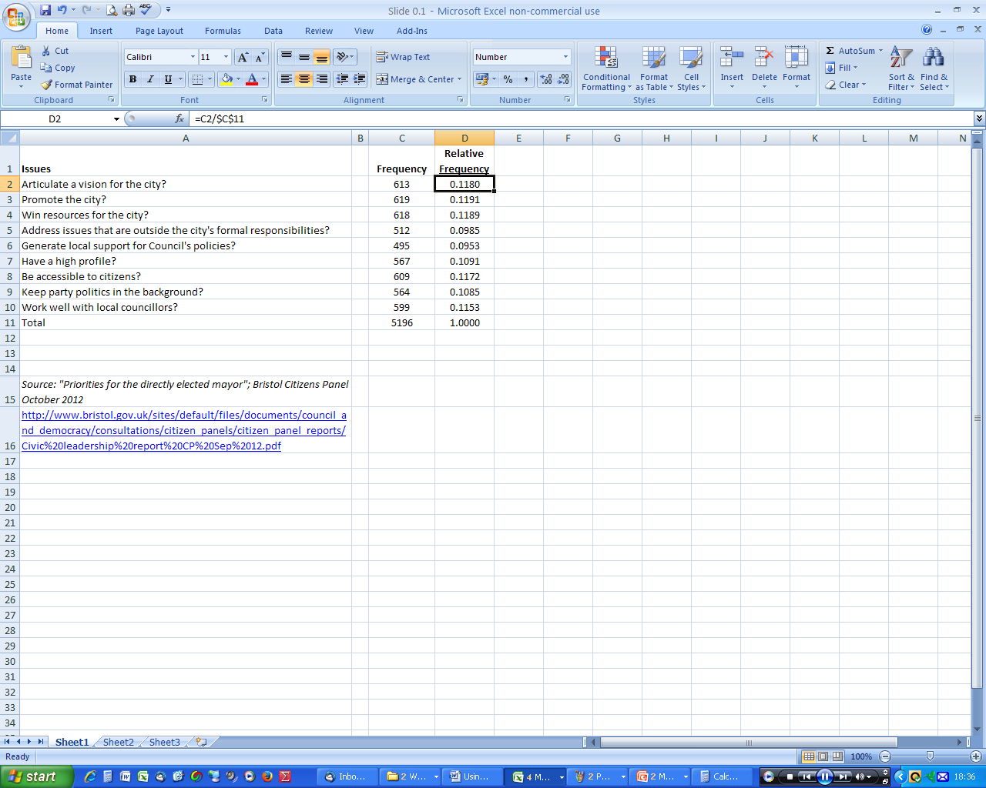
Relative frequency is frequency divided by total; e.g. 613/5196
Total of relative frequencies should equal 1
Now we need the natural logarithms ...

Slide 5
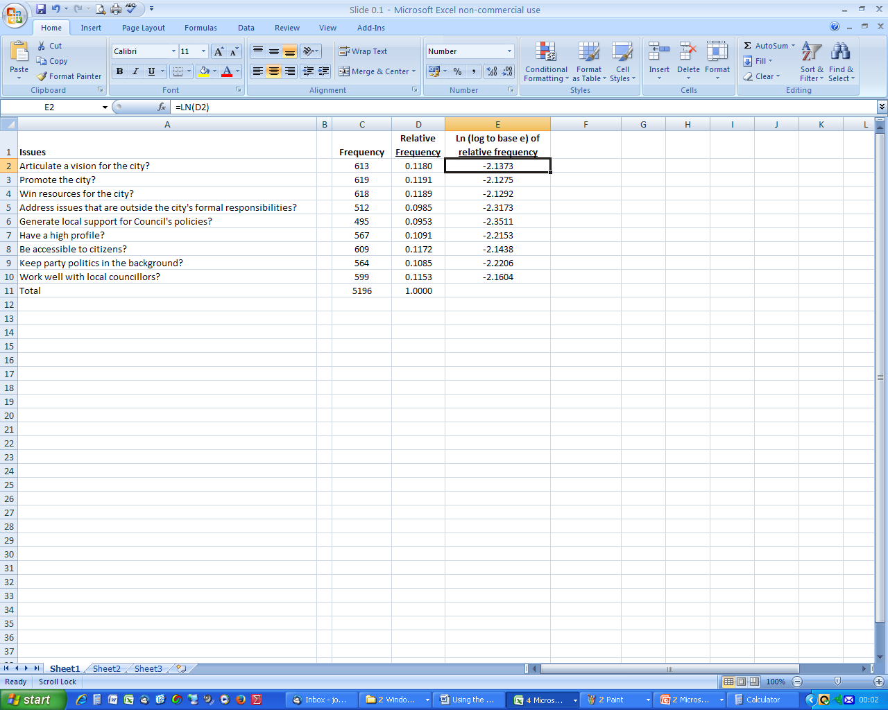
If you’re familiar with logarithms you will be OK with this step. If not, just let Excel take the strain: insert the formula LN (D2) in cell E2 then copy down the column.

Slide 6
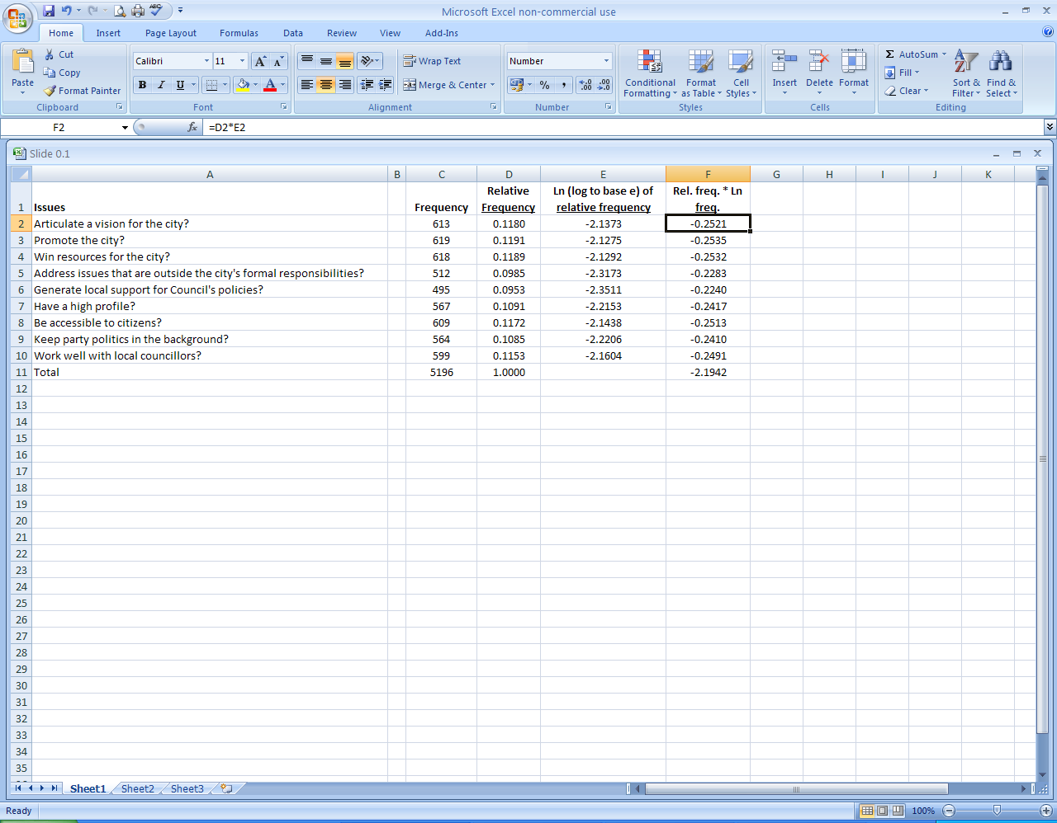
Now multiply Col. D by Col. E ...
... and total this column.
Nearly done ...

Slide 7
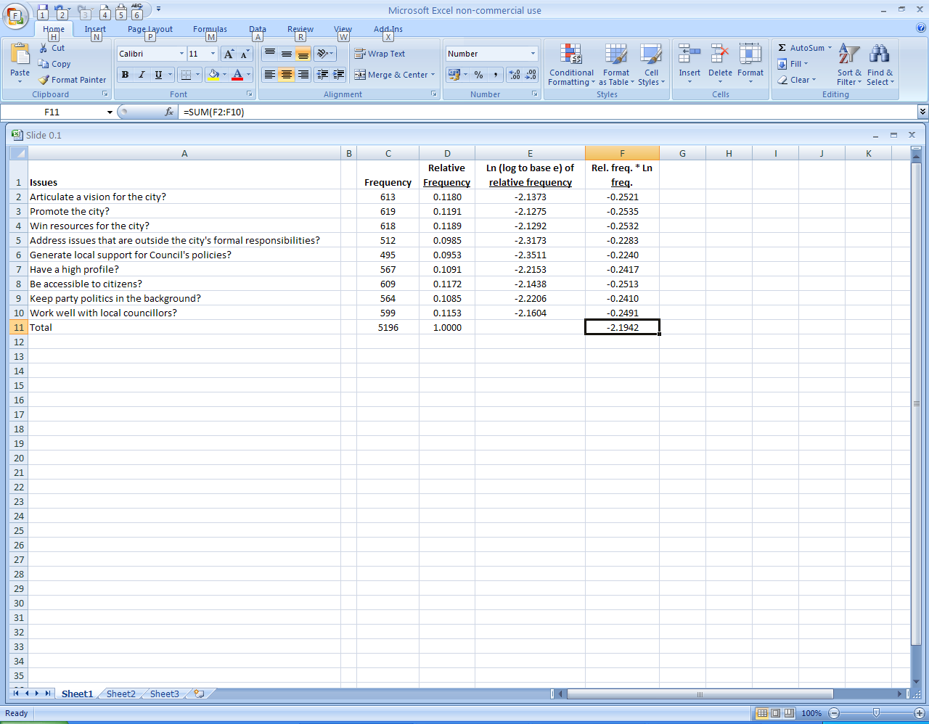
Take the total of Col. F, and multiply by -1, giving us 2.1942 in this case.
Just one more thing to do ...

Slide 8
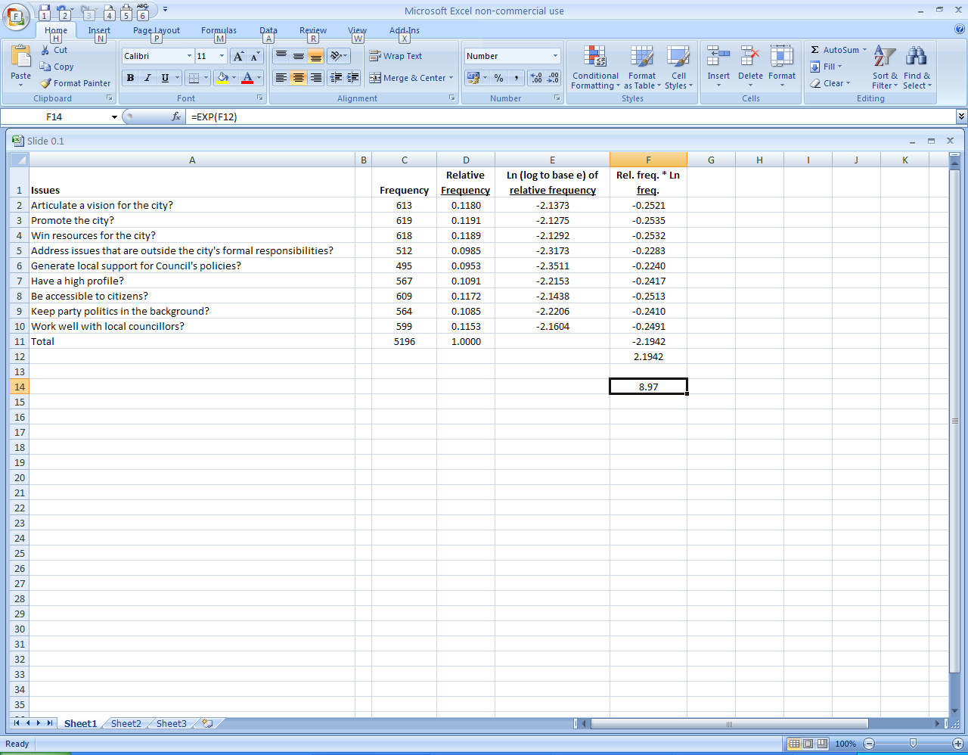
This is the Shannon Index H’
Last step: raise e to the power H’ by using the formula exp H’. This gives you the Effective Number of Issues.

